Slide 1
Understanding C code
Naren Nallapareddy
nxn151@case.edu

Slide 2
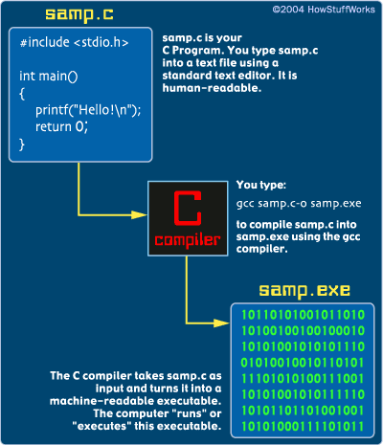
C Language
Compiled (vs scripting) language
GCC is the GNU C Compiler
To compile a c code
gcc example.c –o example (.exe in windows it will be exe and in Linux just a binary file that Linux can execute)

Slide 3
Simple C code
#include <stdio.h> // Standard buffered input and output
int main()
{
printf("This is output from my first program!\n");
return 0;
}

Slide 4
#include – Preprocessor directive
It tells the compiler to “include” the name.h at the end of directive to be copied onto the c file at compilation.
stdio.h in previous code is necessary to use printf function
It contains useful function definitions to read input from keyboard and write output to a screen

Slide 5
int main()
This is a necessary function in any c code
Execution starts at main function
This main function returns an integer value hence ‘int’ in front of main()
return at the end returns the execution back to shell with a return value of 0. This implies the code was run successfully

Slide 6
{ }
In c, a code block is encapsulated by curly braces. There are no hard and fast rules for spaces, tabs or new lines in c
#include <stdio.h>
int main(){printf("This is output from my first program!\n");return 0;}
This is a valid c code!

Slide 7
Let’s up the complexity!

Slide 8
#include <stdio.h>
#define MAX 10
int a[MAX];
int rand_seed=10;
/* from K&R
- returns random number between 0 and 32767.*/
int rand()
{
rand_seed = rand_seed * 1103515245 +12345;
return (unsigned int)(rand_seed / 65536) % 32768;
}
void bubble_sort(int m)
{
int x,y,t;
for (x=0; x < m-1; x++)
for (y=0; y < m-x-1; y++)
if (a[y] > a[y+1])
{
t=a[y];
a[y]=a[y+1];
a[y+1]=t;
}
}
void main()
{
int i,t,x,y;
/* fill array */
for (i=0; i < MAX; i++)
{
a[i]=rand();
printf("%d\n",a[i]);
}
bubble_sort(MAX);
/* print sorted array */
printf("--------------------\n");
for (i=0; i < MAX; i++)
printf("%d\n",a[i]);
}

Slide 9
#define
#define directive allows the definition of macros within your source code
Compiler simply copies the value wherever the variable name is used
For example #define pi 3.14 so we can use pi instead of 3.14 every time.

Slide 10
Functions
int rand() : takes no input and return a integer when called
void bubble_sort(int m): return nothing, but takes an integer m

Slide 11
Data types
int or signed int | 2 | -32,768 to 32767
unsigned int | 2 | 0 to 65535
short int or signed short int | 1 | -128 to 127
unsigned short int | 1 | 0 to 255
long int or signed long int | 4 | -2,147,483,648 to 2,147,483,647
unsigned long int | 4 | 0 to 4,294,967,295
Type | Size(bytes) | Range
Float | 4 | 3.4E-38 to 3.4E+38
double | 8 | 1.7E-308 to 1.7E+308
long double | 10 | 3.4E-4932 to 1.1E+4932
Type | Size(bytes) | Range
char or signed char | 1 | -128 to 127
unsigned char | 1 | 0 to 255

Slide 12
a % b
Modulo operator
10%3 = 1 and 10/3 = 3

Slide 13
a[y]
Find value at y of the array pointed by a
Lets say int a[2] = {1, 2}
a[0] will have value 1
a[2] = ?

Slide 14
Global variable
a in the code
Value updated in function as well as inside main (which itself is a function!)

Slide 15
Let’s up the complexity more!

Slide 16
#include <stdio.h>
#include <string.h>
#include <stdlib.h>
int main()
{
FILE *myfile = fopen("out.top.txt","r");
char a[500] = "this is about as big as this line will be";
while (fscanf(myfile,"%[^\n]\n",a)==1) {
char *b1 = strtok(a," ");
if (atoi(b1) > 0) {
char *b2 = strtok(NULL,", ");
if (!strcmp(b2,"root"))
printf("%s owner is %s\n",b1,b2);
}
}
}

Slide 17
REGEX
"%[^\n]\n”
%[^\n] - any data that is not \n
\n until newline character is reached then return 1 and exit

Slide 19
strtok
Split string into tokens
“This is an example” - recursive calls to strtok with token “ “ will give
This
is
an
example.
char *b2 = strtok(NULL,", "); // The point where the last token was found is kept internally by the function to be used on the next call

Slide 20
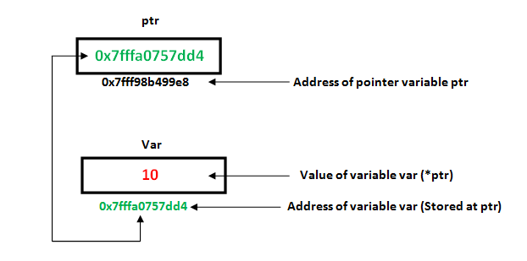
Pointers
#include <stdio.h>
int main()
{
int Var = 10;
int *ptr = &Var;
printf("Value of Var = %d\n", *ptr);
printf("Address of Var = %p\n", ptr);
*ptr = 20; // Value at address is now 20
printf("After doing *ptr = 20, *ptr is %d\n", *ptr);
return 0;
}
&-> address of
*-> points to (also called derefencing operator)

